Slide 1
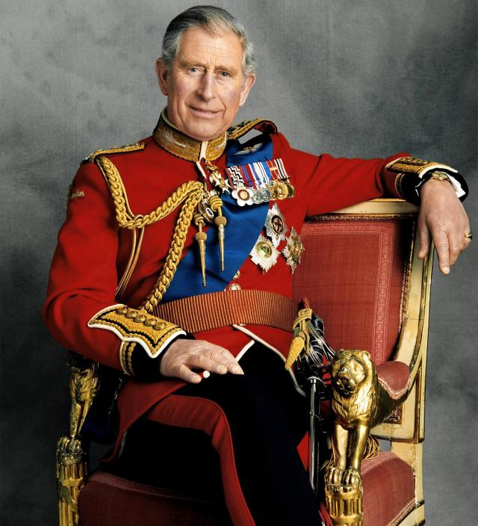
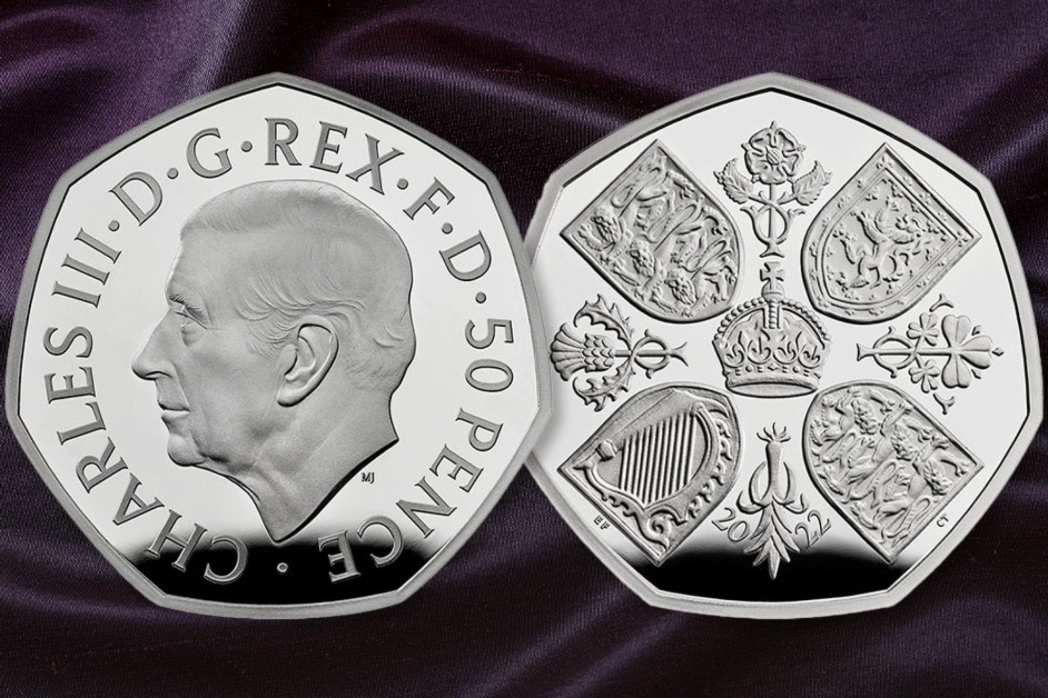
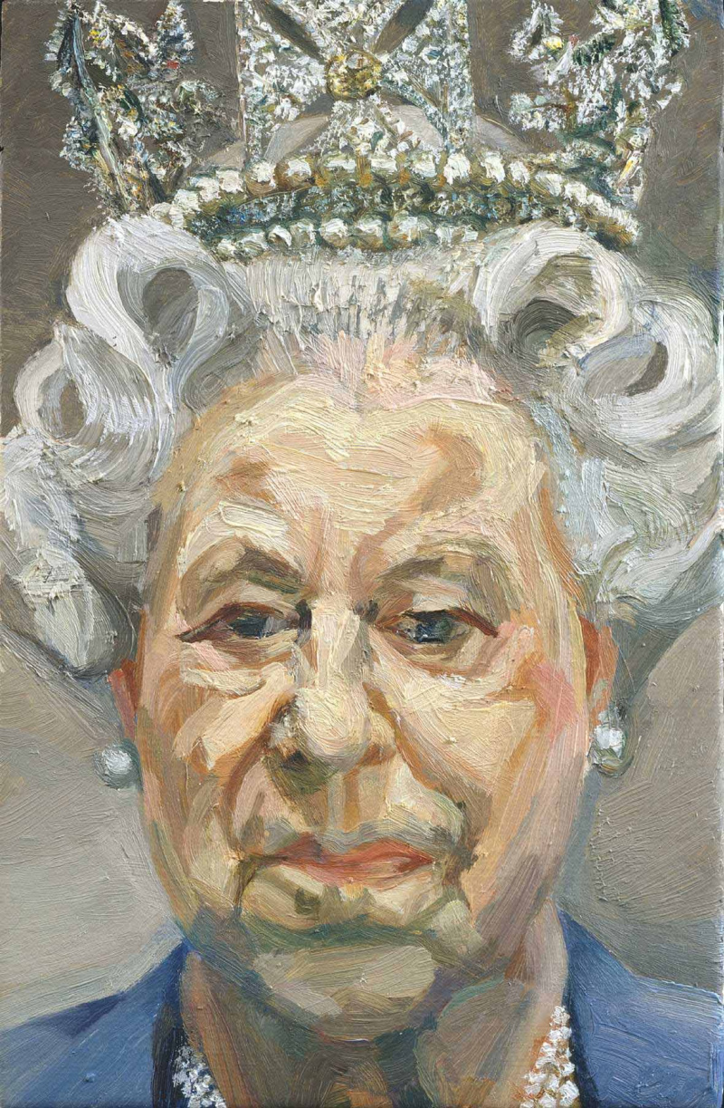
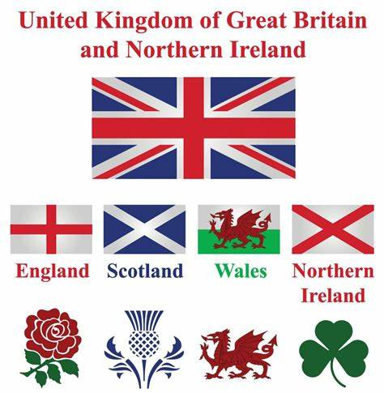
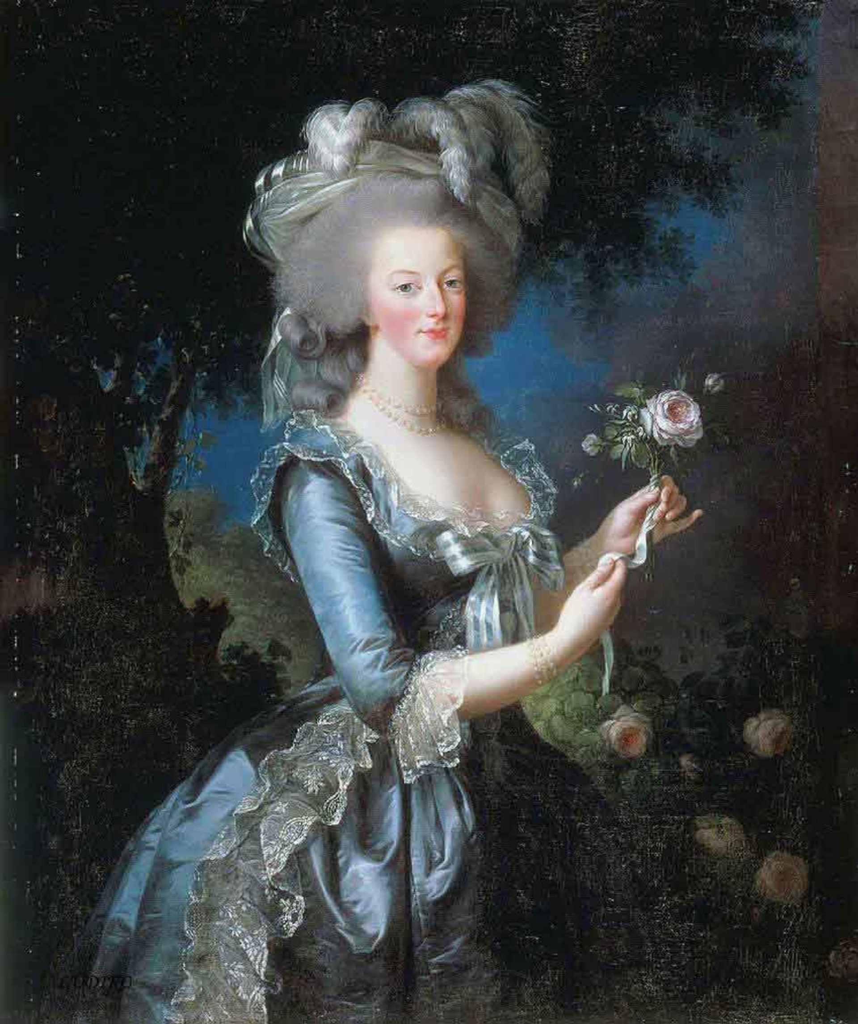
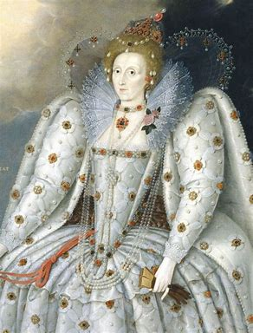
Theme One : Kings and Queens
Lucien Freud

Slide 2
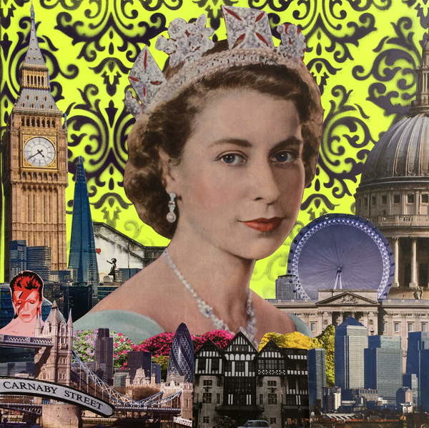
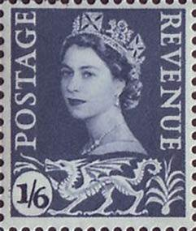
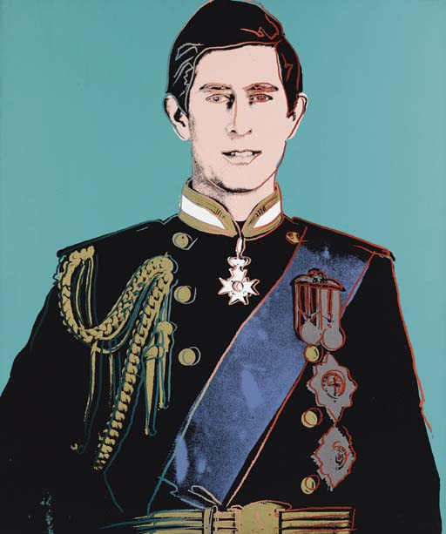
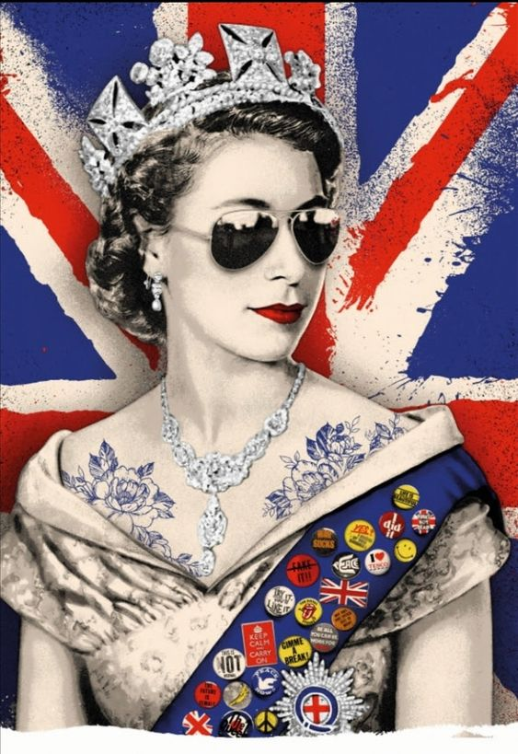
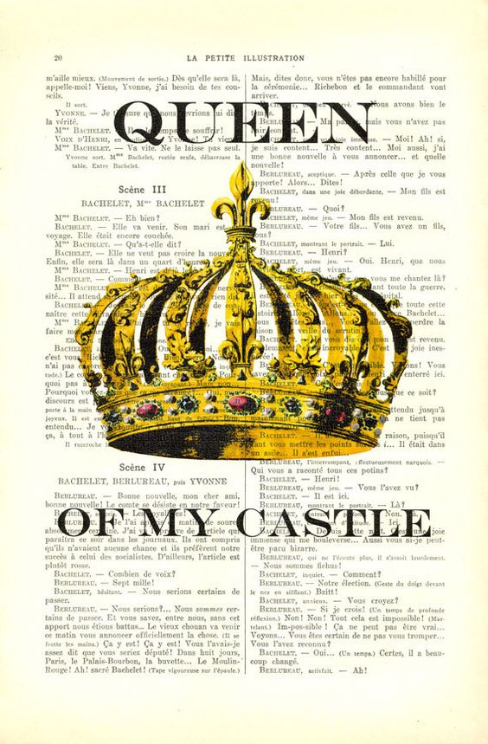

Slide 3
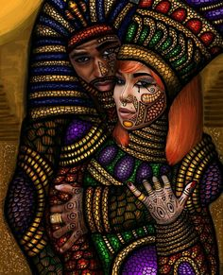
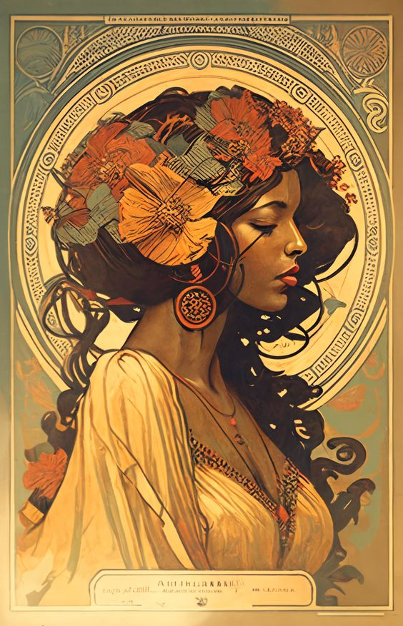
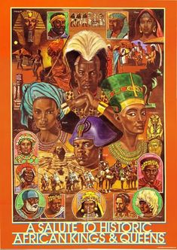
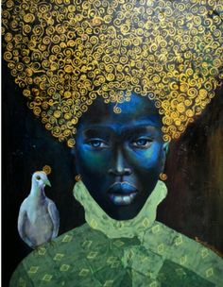
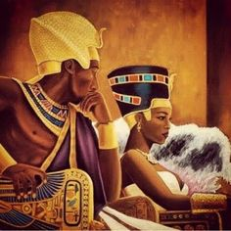

Slide 4
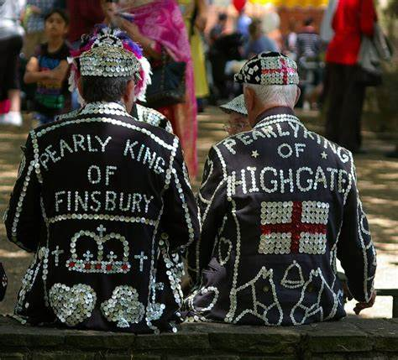
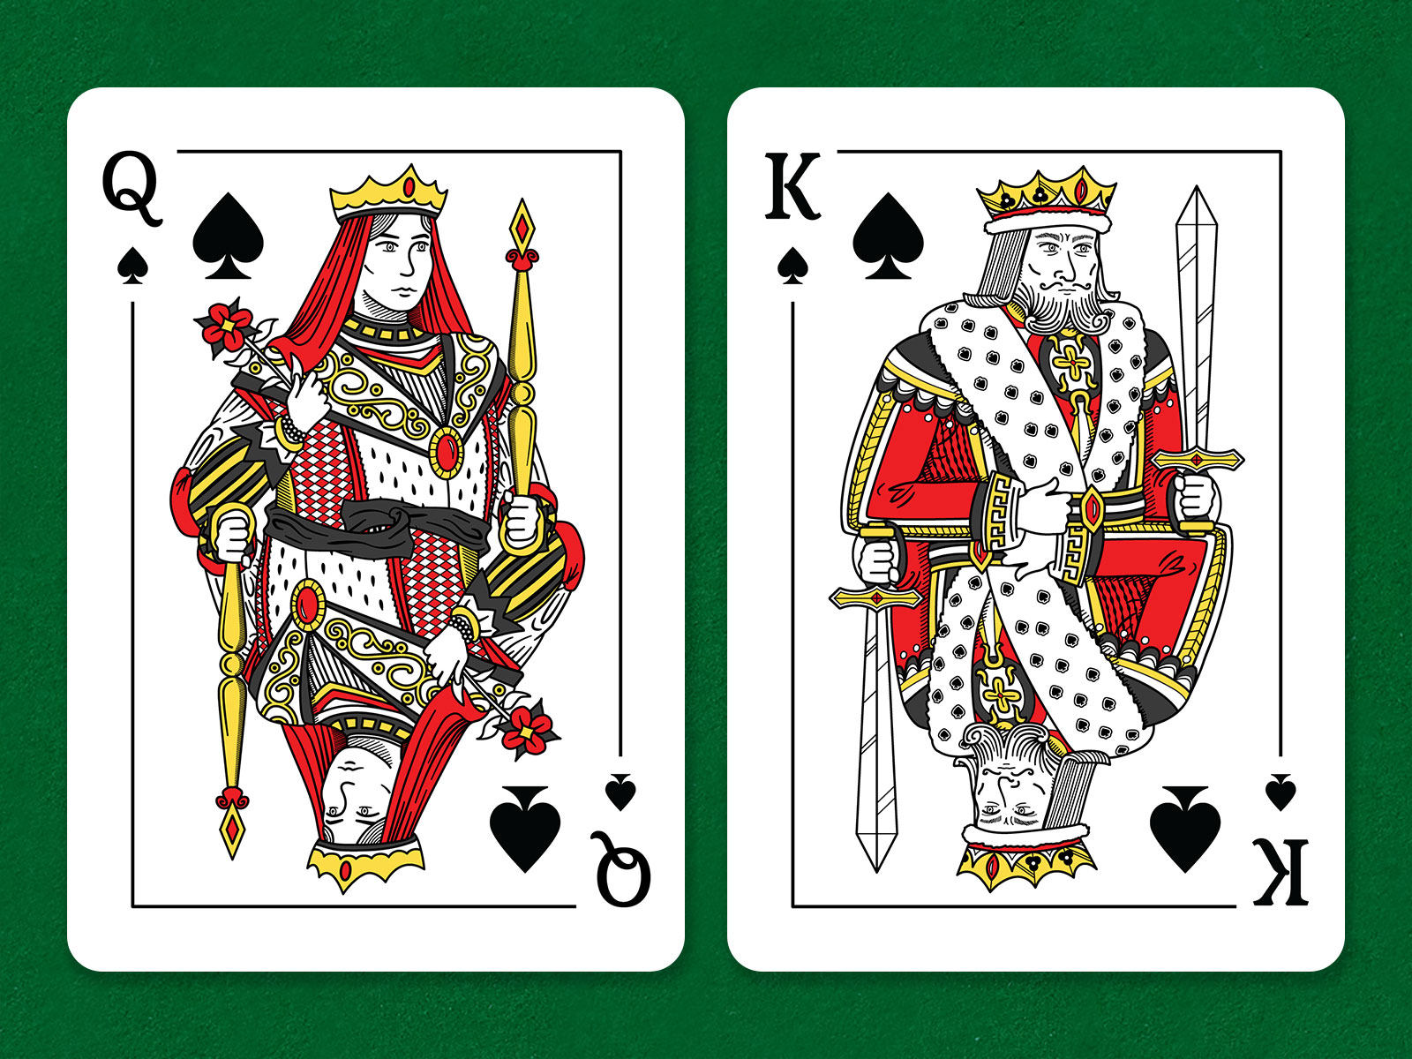
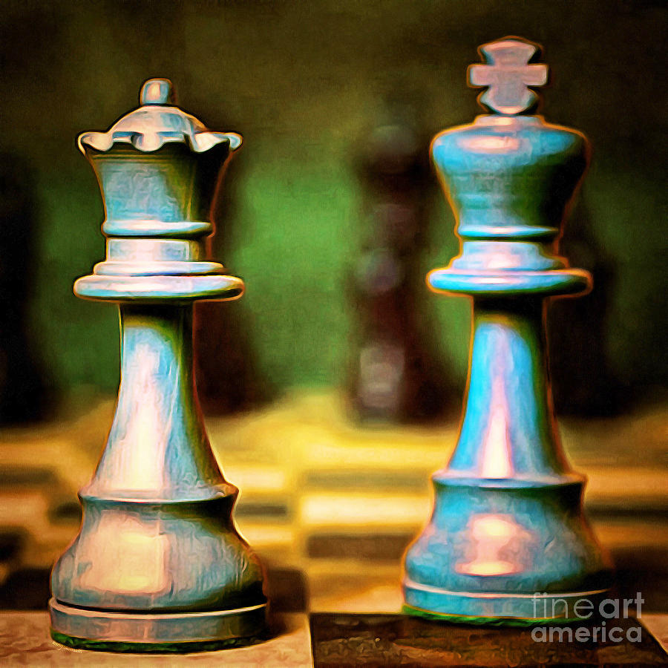
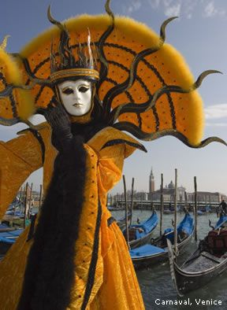
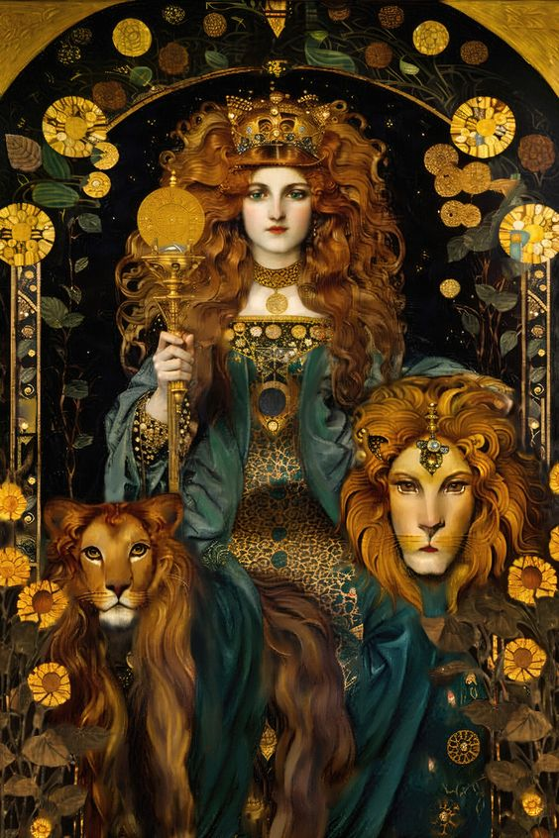
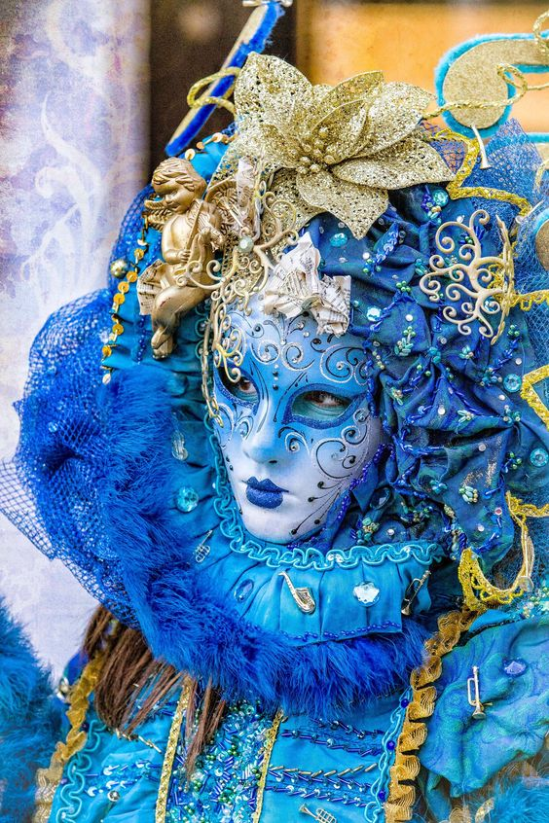
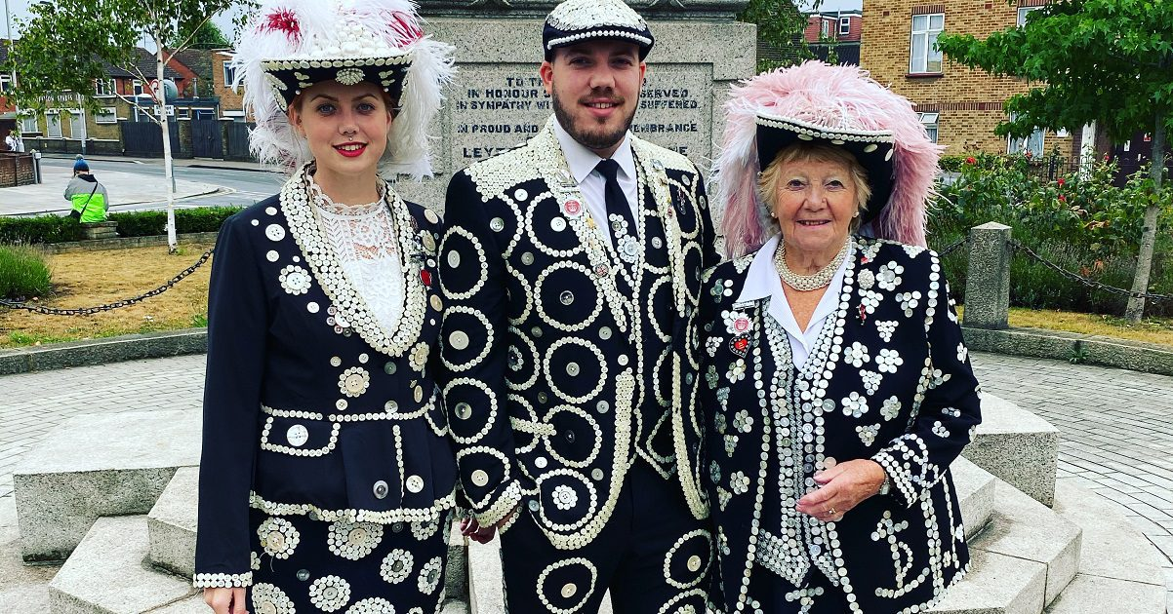

Slide 5
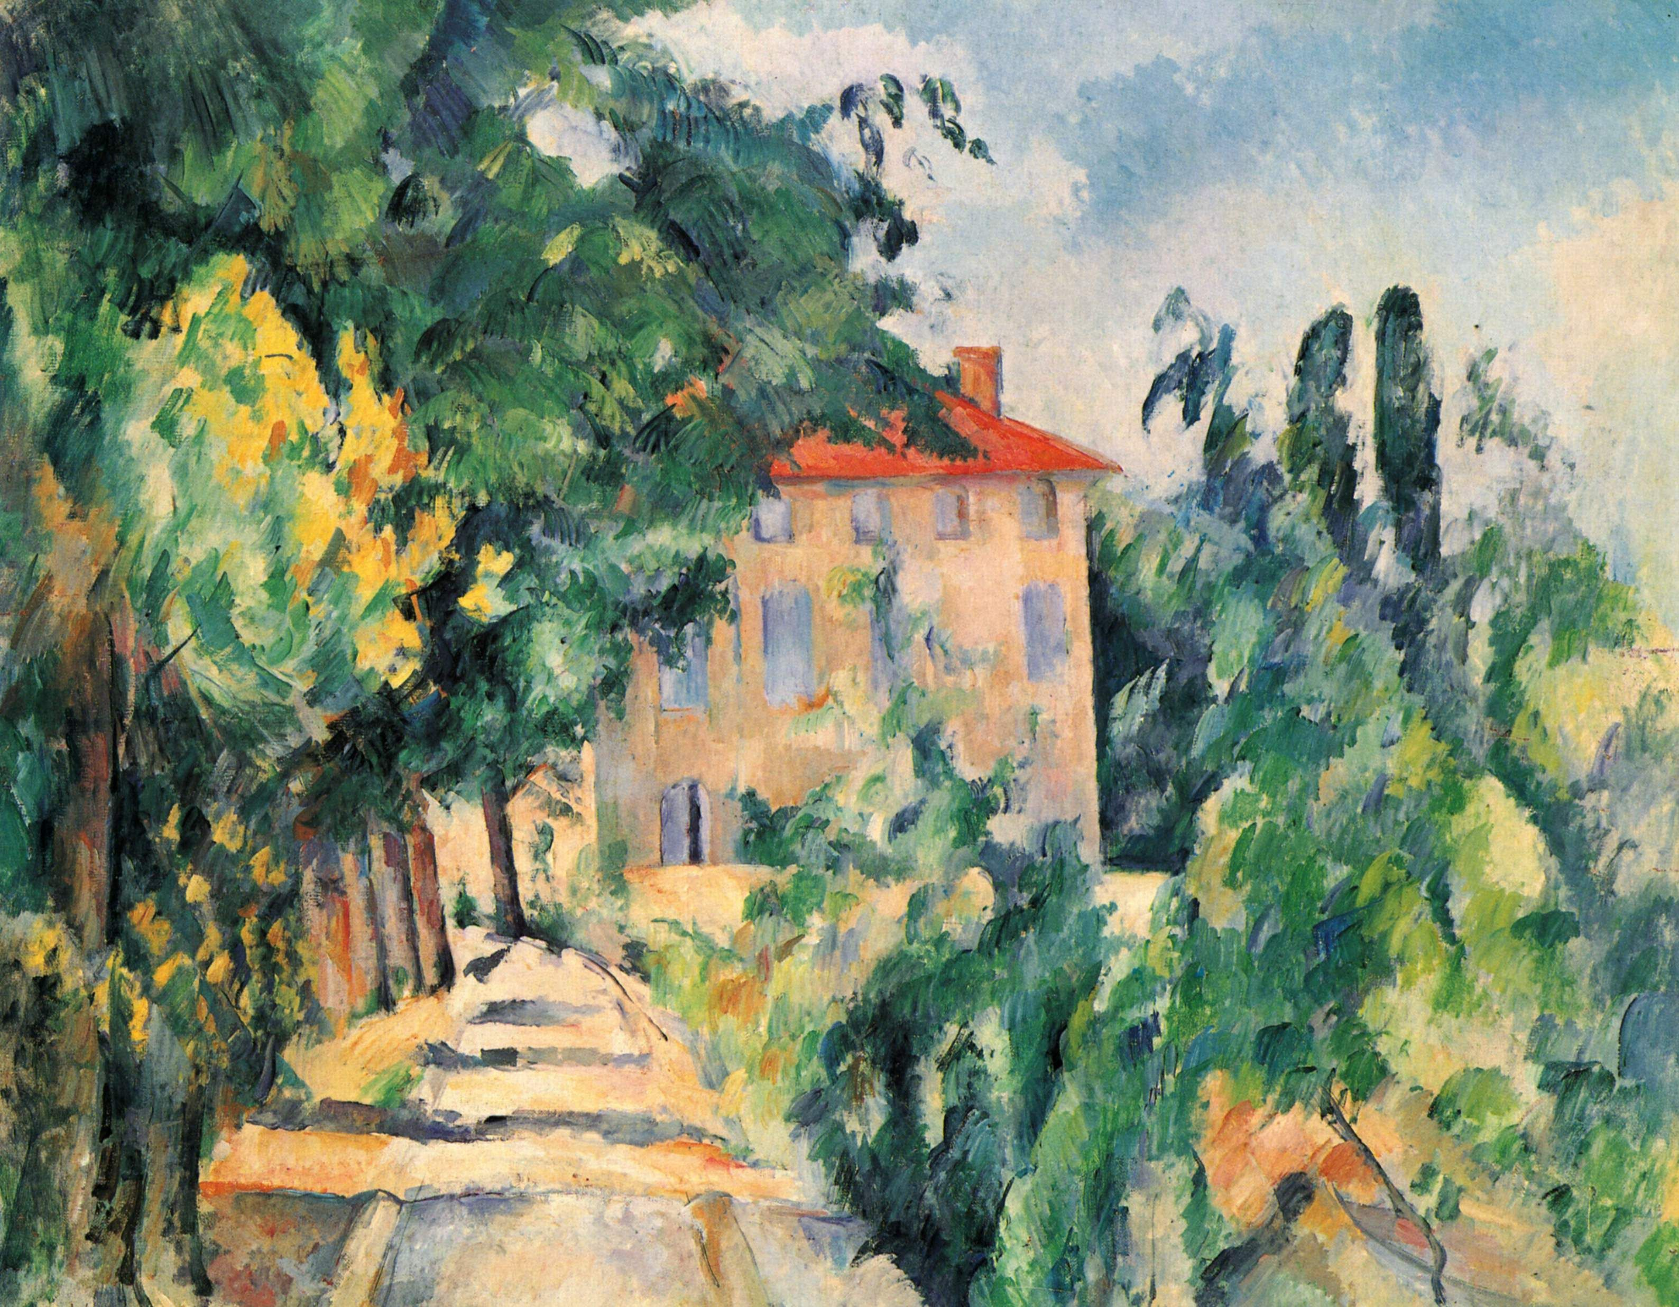
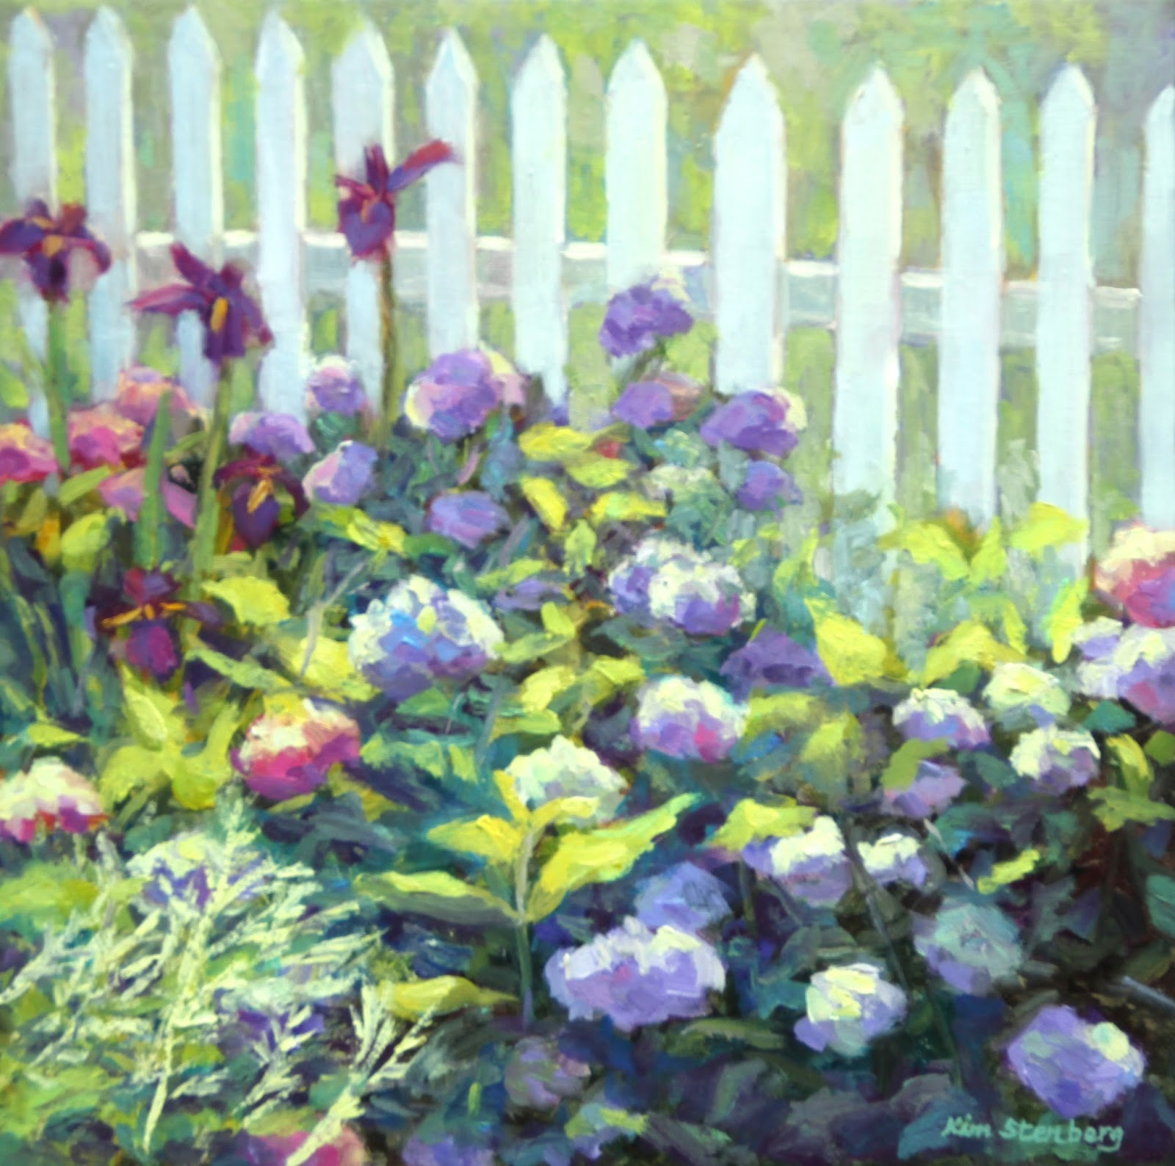
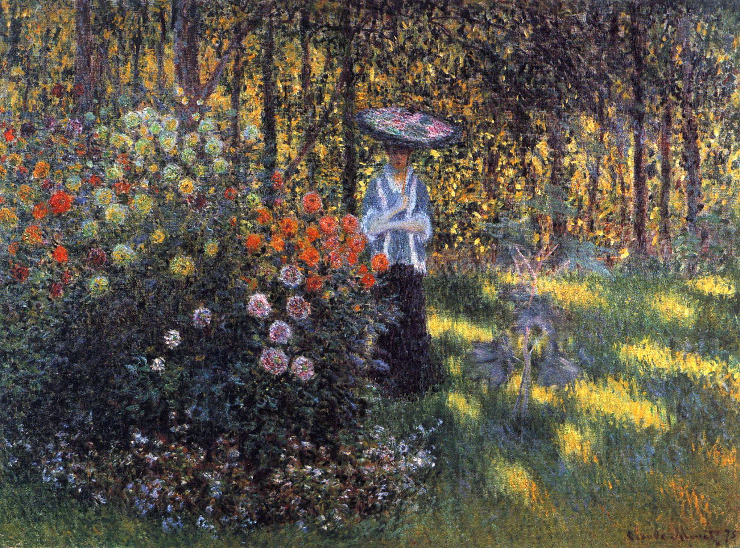
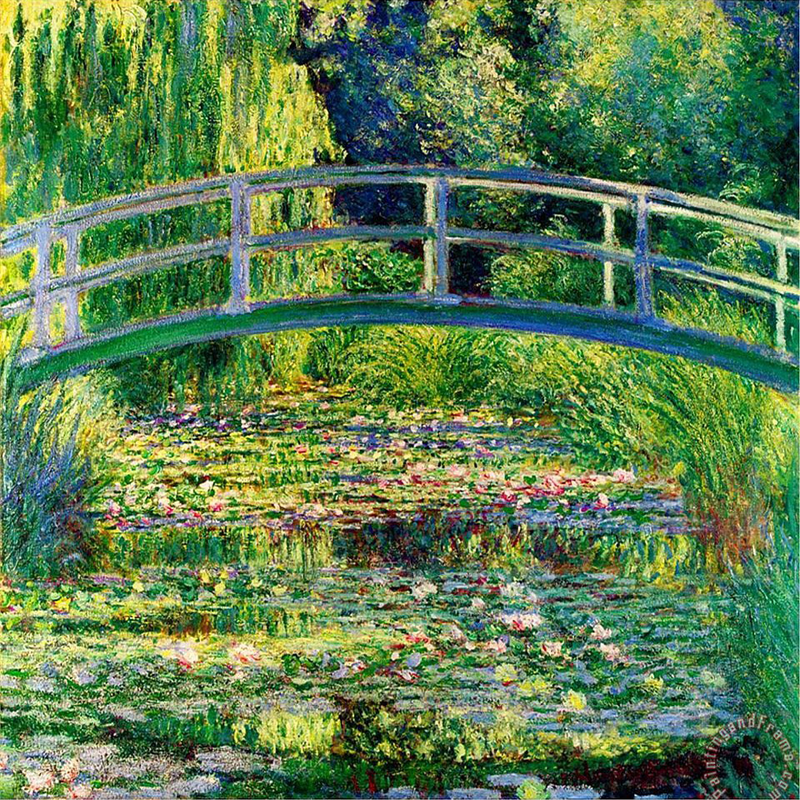
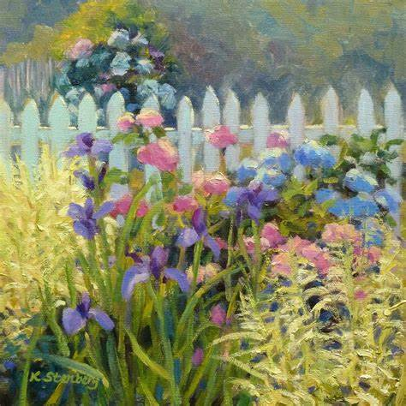
Paul Cezanne was a post- impressionist who painted landscapes that might include gardens in the view
Theme Two: Garden
Kim Stenberg
Monet was a French impressionist most famous for painting his garden.
George Nelson was also painting in this style

Slide 6
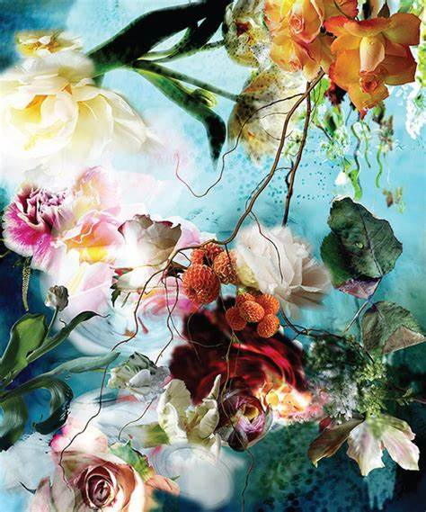
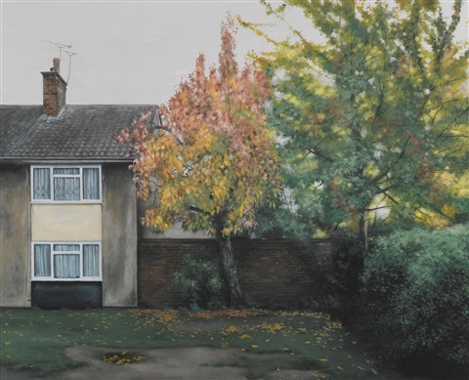
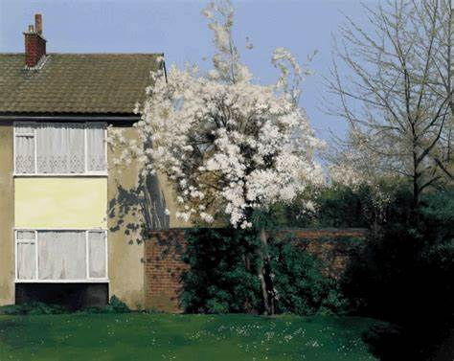
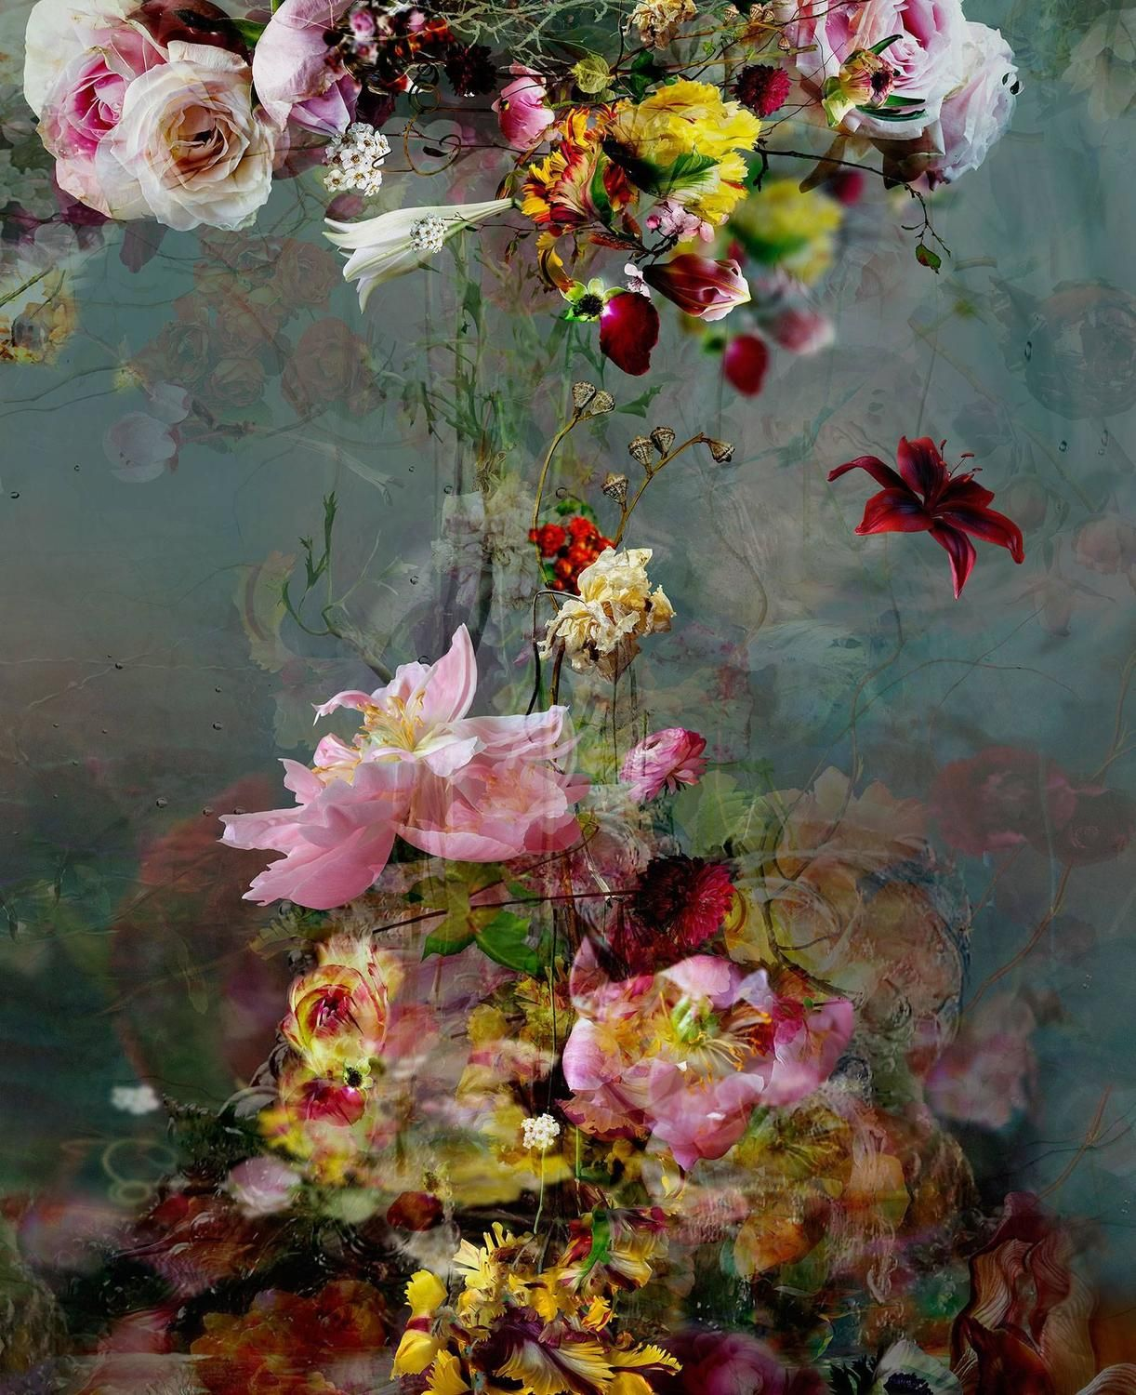
George Shaw's work records our urban environment
Isabelle Menin's work is very realistic and has a vintage/romantic feel to it.

Slide 7
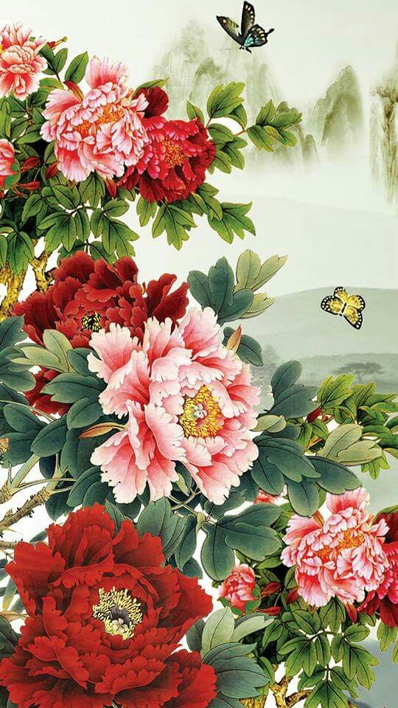
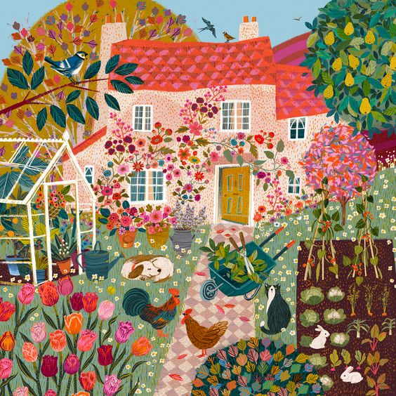
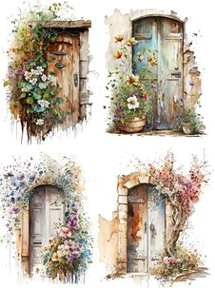
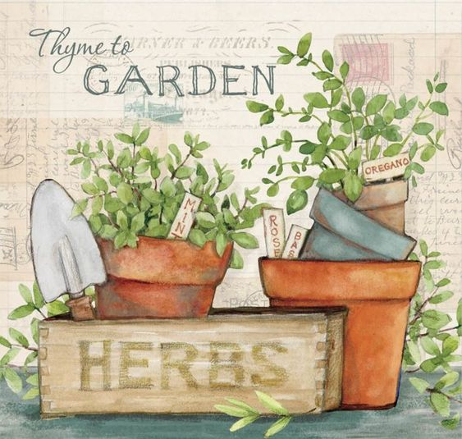
Chinese art/ American folk art and thoughts on doorways, gates and fences.....

Slide 8
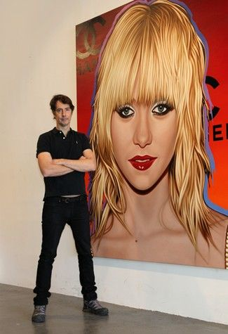
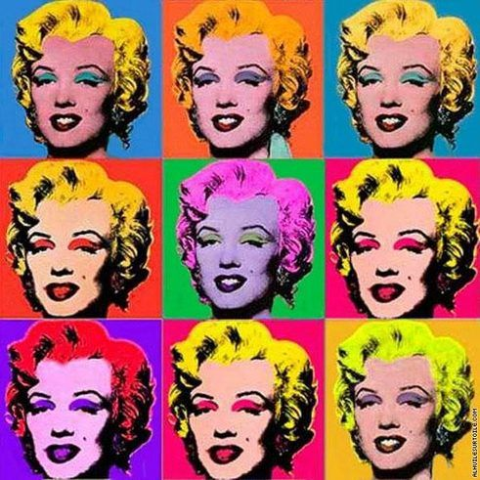
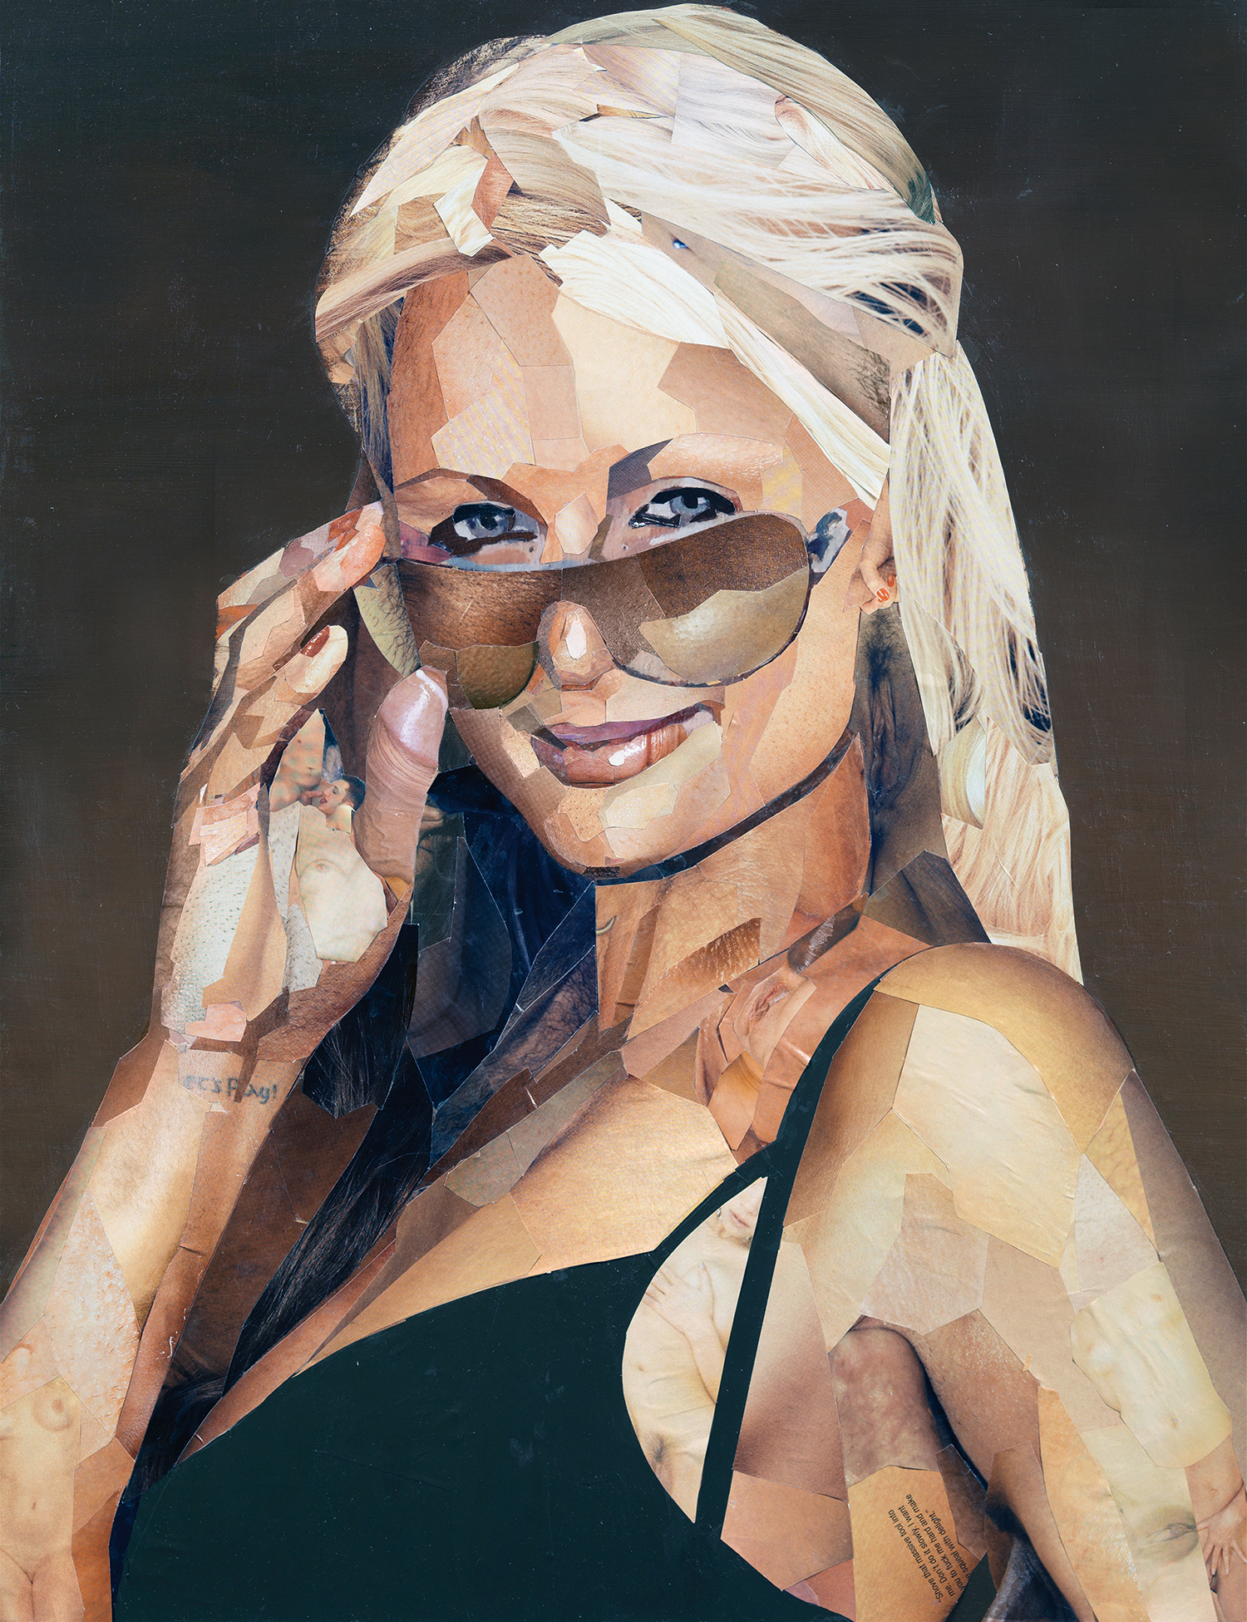
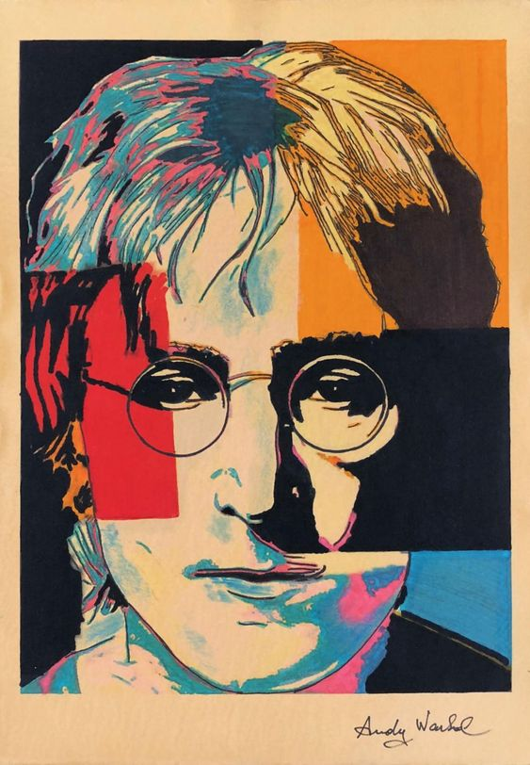
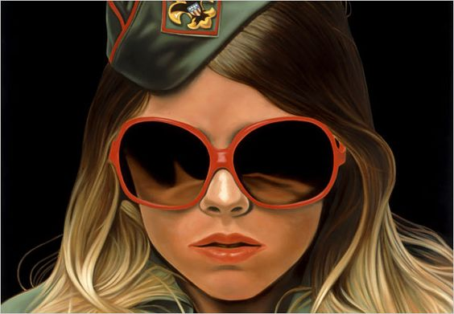
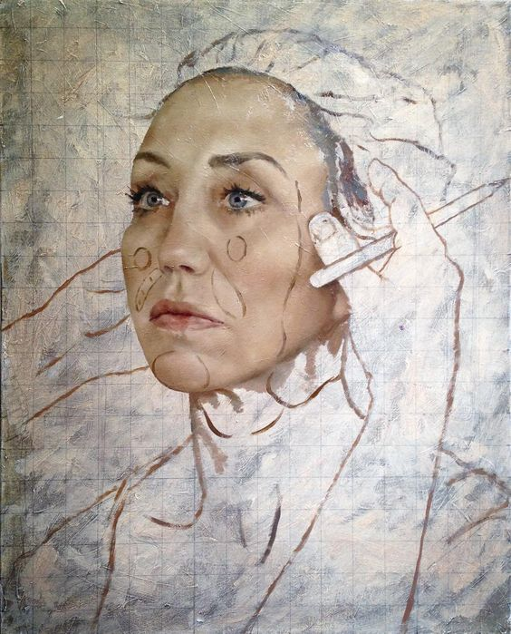
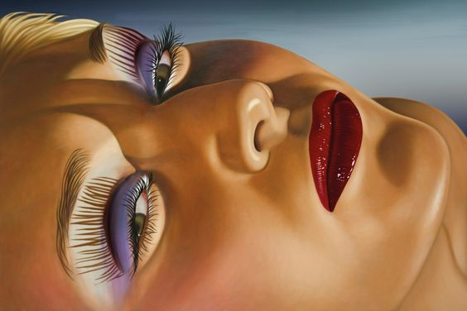
Andy Warhol- Pop Artist
Theme Three: CELEBRITY
Richard Phillips
Paris Hilton by Jonathon Yeo J.YEO

Slide 9
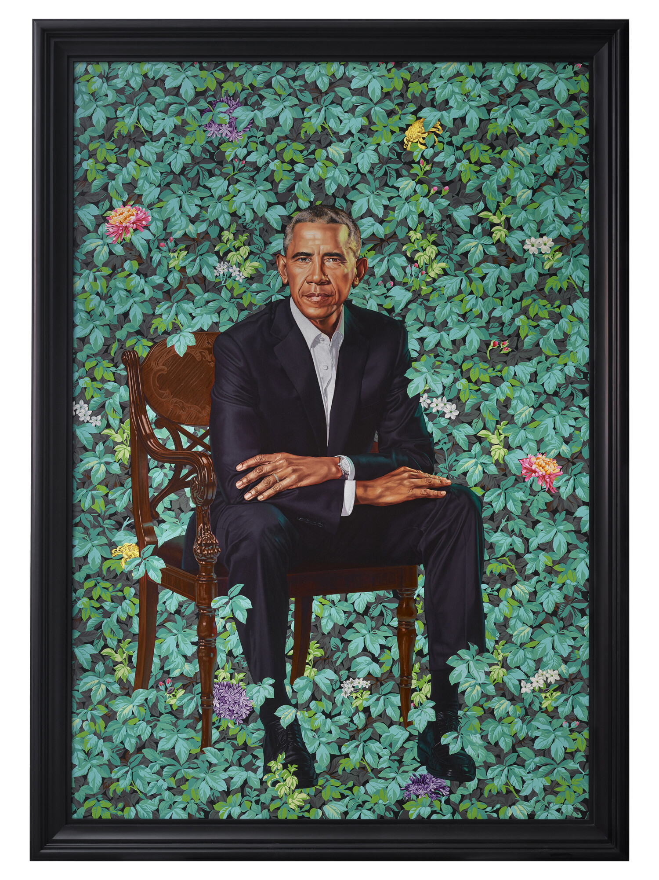
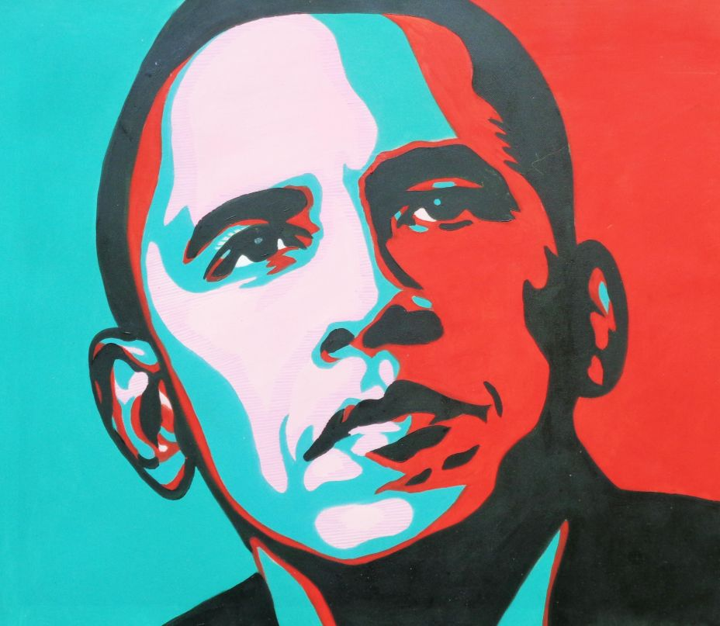
Pop Art Obama by Ana Candelaioull
Kehinde Wiley – an American portrait painter was commissioned to paint this picture of Obama. He takes produces portraits of folk in the style of some of the grand masters of our time.
Kehinde Wiley

Slide 10
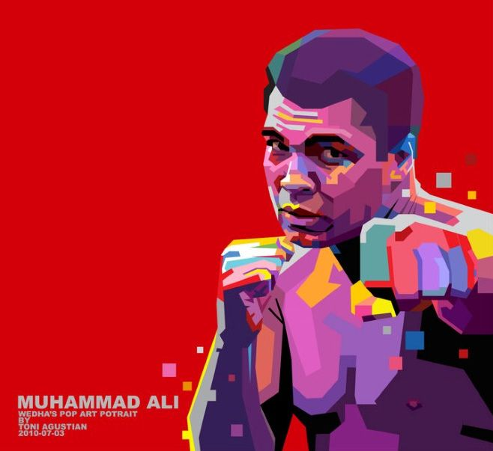
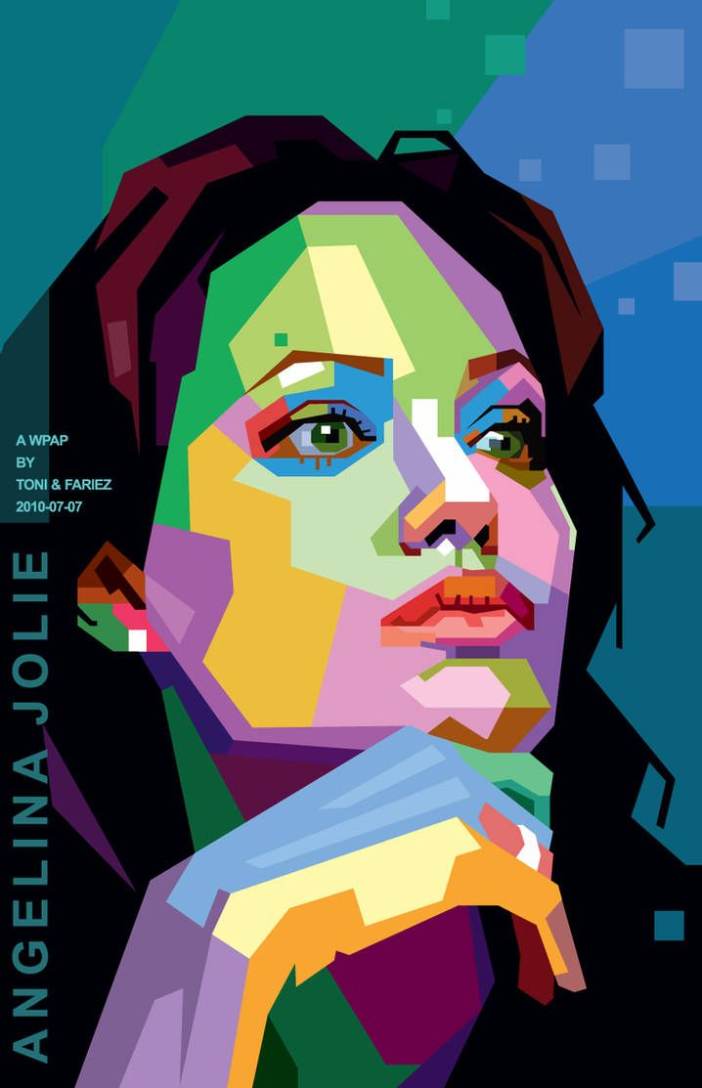
Toni Agustian – Celebrity portraits include people from all walks of life.

Slide 11
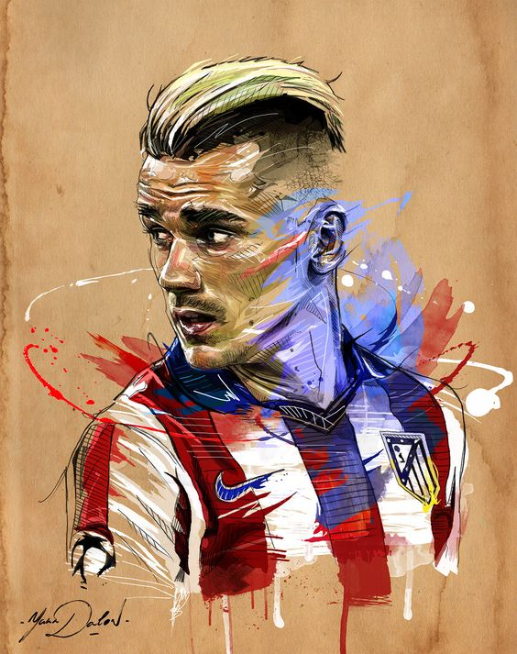
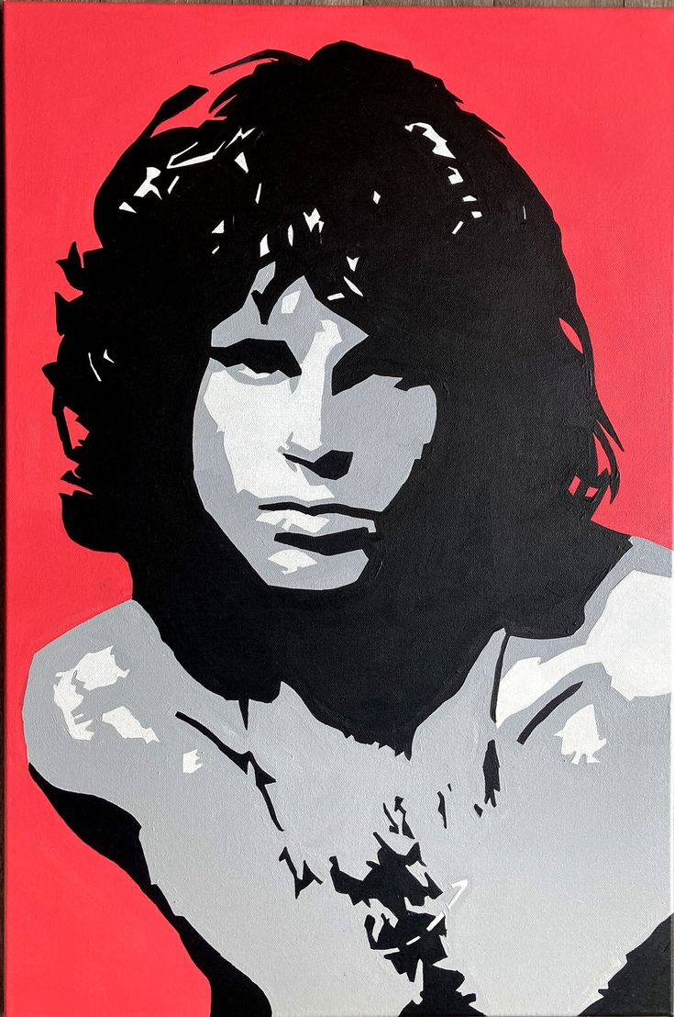
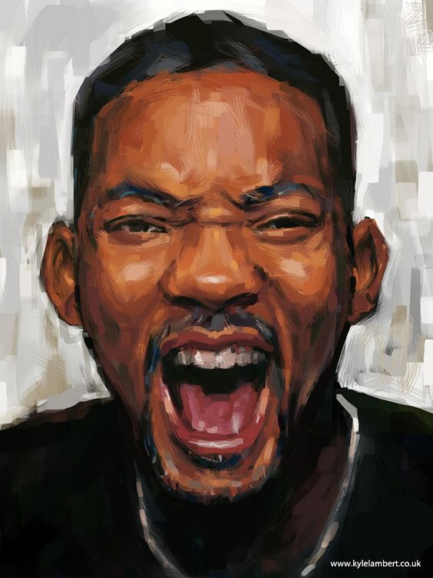
Think anybody who is famous- sports, television, film, theatre, Music ...
This Photo by Unknown author is licensed under CC BY-NC.

Slide 12
Theme Four: SPACE
Paul Calle
paints Neil Amstrong
Alizey Khan is inspired by views of space- the stars and constellations therein.
Micheal Kagen literally paints scenes connected with the Space industry

Slide 13
Etienne Leopold Trouvelot is famous for his astronomical drawings

Slide 14
HOPPER, WYETH AND ESCHER- ALL THEIR WORKS EXPLORES USING SPACE IN ART

Slide 15
Theme Five: SHOPPING
Banksy , Kruger and Gurskey all make Art to provoke thought about what buy and how we use it
Lisa Milroy

Slide 16
Doreen Fletcher and Richard Estes paint urban city center scenes

Slide 17
Nathalie Le Croc

